Slide 1
COLUMBIA ANALYTICS PROJECT
Jan 2024 Kick off

Slide 2

PART 1 – OPENING KEYNOTES
INVESTMENT SOLUTIONS
Ardian Customized Solutions
Private Wealth Solutions
INVESTMENT ACTIVITIES
PRIVATE EQUITY
US$119BN
Secondaries & Primaries
Buyout
Expansion
Growth
North America Fund
US$160BN
OF ASSETS MANAGED OR ADVISED
Co-Investment
Ardian is a world-leading private investment house that provides solutions through its broad range of capabilities and expertise.
REAL ASSETS
US$31BN
Infrastructure
Real Estate
Real Assets Debt
CREDIT
US$10BN
Private Debt
NAV Financing

Slide 3
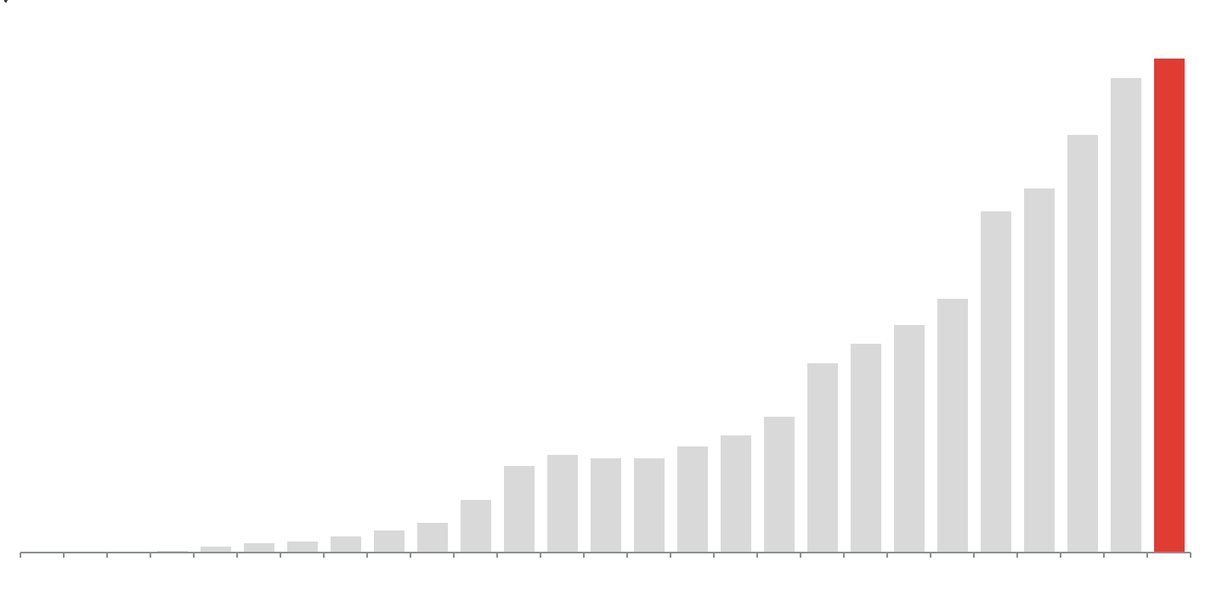
ARDIAN HISTORY
PART 1 – OPENING KEYNOTES
REAL ASSETS DEBT
CLEAN H2 INFRA
$141
Three essential pillars guide our growth
DOMINIQUE
SENEQUIER CREATES ARDIAN
NAV
FINANCING
INFRASTRUCTURE
CO-INVESTMENT
PRIVATE DEBT
INFRASTRUCTURE
AMERICAS
NORTH
AMERICAN
BUYOUT
EARLY SECONDARY
REAL ESTATE
A NEW CHAPTER:
Entrepreneurship
SECONDARY
EXPANSION
GROWTH
EUROPEAN
BUYOUT
Excellence
MANDATES
Loyalty
LONDON
NEW YORK
SINGAPORE
ZURICH
BEIJING
MADRID
TOKYO
PARIS
FRANKFURT
MILAN
LUXEMBOURG
SAN
FRANCISCO
SANTIAGO
JERSEY
SEOUL
Source: Ardian, as of May 2022. AuM as of March 31st, 2022. Assets Under Management in USD billion. Information provided for illustrative purposes only ,without any binding contractual force.

Slide 4
CONTINUING THE SUCCESSFUL INVESTMENT THESIS OF ARDIAN INFRASTRUCTURE IN THE AMERICAS
PART 1 – OPENING KEYNOTES
OK
ARDIAN INFRA STRATEGY FOUNDED IN EUROPE SUCCESSFULLY EXTENDED TO AMERICAS
Consistent and proven investment strategy
Regional focus backed by a global team
Diversified value proposition designed for our investors
AAIF reflects Ardian’s strategic targets: disciplined portfolio construction, active asset management and LP-centric
Focused on essential infrastructure diversified across all verticals
Value creation through an industrial mindset, energy transition and data-driven infrastructure
Regional mid-market focus to deliver optimal risk return position
Local team supported by transversal functions and deep team of operating partners
Unique deal flow from the sourcing of a highly experienced local team and from European strategic partners
AAIF IV offered LPs exposure to the Americas market with a club deal approach
Globally diversified LP base supporting our local offering
Persistent support from strong LP base, plus growth from new LP relationships
Recurrent co-investment opportunities (80% of AAIF IV transactions offered for co-investments)
Target investment strategy delivered with AAIF IV, and continuing with AAIF V

Slide 5


FOCUS ON DATA-DRIVEN STRATEGY AND VALUE CREATION
PART 1 – OPENING KEYNOTES
A DEDICATED TEAM NOW SUPPORTING VALUE CREATION ACROSS THE FULL INVESTMENT LIFECYCLE
1
2
INDUSTRIAL PARTNERSHIPS
DUE DILIGENCE
Deployment of Ardian data products beyond portfolio assets to get access to more market intelligence and become a sought-after intelligence provider
Pilot projects with Renewable Energy asset managers thanks to Opta platform to get access to their data in exchange for Ardian’s data intelligence
2
Support identification of upsides not factored by potential competitors and challenge due diligence results
Informed hedging and investment decisions based on the impact foreseen on the overall risk assessment
Systematic questionnaire to assess data/IT maturity of targets and key priority actions
1
1
2
DATA-DRIVEN VALUE CREATION
4
ASSET MANAGEMENT
EXIT VALUE
3
4
4
3
Partnerships with innovative players to find new growth levers such as Skyport and Milan Airport partnership for the development of electric air mobility
Optimized operations to ensure long-term value
Decarbonization initiatives for transport infrastructure
Ongoing support to operational excellence of renewable assets
3
Driving operational excellence & sustainability to ensure long-term resilience
Supporting digital transformation plan of management teams
Participating in 100-day plan construction
ONGOING INITIATIVES FOR 2023
DIGITAL INFRA
Re-think processes and digital tools to ensure scalability in the context of carve-out from Casino
Passengers commuting at Milan Airports
Optimization of take-off and landing trajectories with Naples Airport
Improvements of GSE emissions measurement with Turin Airport
Deployment in external airports
Assessment of future emissions based on traffic forecasts or scenario
Information sharing with road users
Storage assessment
Baseload contracting optimization
Production forecasts
Scoping of a new data product dedicated to digital infrastructure

Slide 6
VESPUCIO

Slide 7


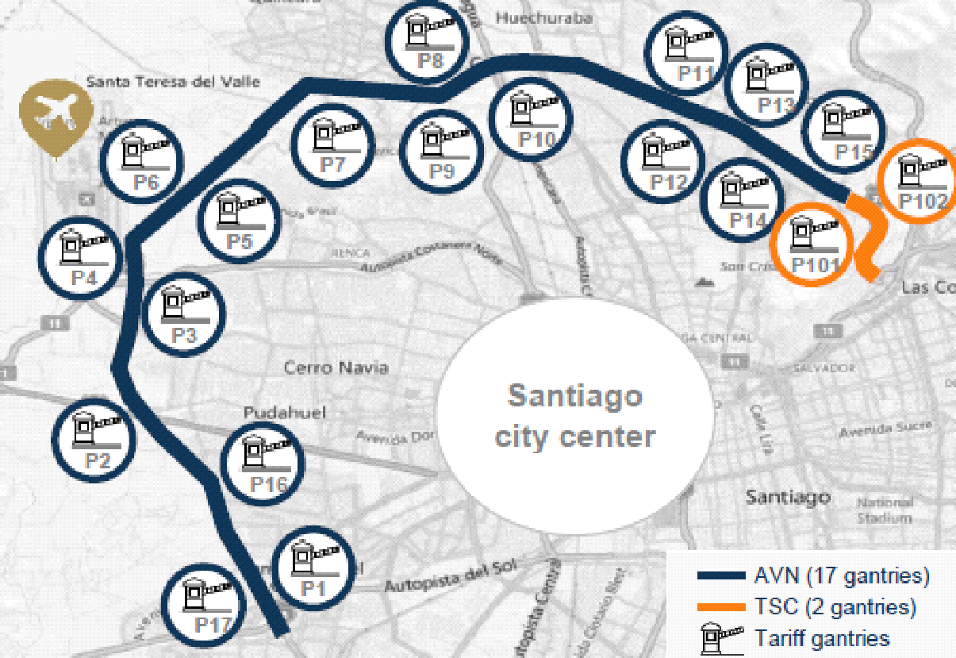

VESPUCIO
PART 2 – GENERAL OVERVIEW
OVERVIEW
Sector: Toll road concessions
Country: Chile
Closing date: February 2020
Activity: Transportation
AAIF IV NAV: $183m
AAIF IV invested amount: $146m
AAIF IV proceeds since inception: $1m
Planned 2023 distributions: $2m
SHAREHOLDING
Vespucio | % of capital
Ardian / CMB BidCo | 33.0%
Ardian Americas Infrastructure Fund IV & Co-Investors | 16.5%
CMB Prime | 16.5%
Globalvia | 34.0%
Frontal Trust | 33.0%
Total | 100.0%
ASSET DESCRIPTION
Two free-flow toll road concessions in Chile with proven history of traffic growth acquired alongside experienced local investor CMB Prime
Autopista Vespucio Norte (“AVN”): 29km, 3x3 expressway bordering Santiago from the north-east to the south-west, built in 2002
Tunel San Cristobal (“TSC”): Two uni-directional 2x2 tunnels, each c.1.8km long under the San Cristóbal hill, built in 2004
Long term cash flow visibility on the back of strong concession contracts with average remaining life of 12 years + extensions
Favorable tariff structure providing surcharges during peak traffic hours
Essential transportation link in Santiago
AVN is the primary urban axis on the north side of the city, connecting to the international airport and other fast growing areas of the city
Management team with more than 30 years collective industry experience
The sale of Brookfield's final stake to Globalvia late 2021 validated Ardian valuation, according to rumored purchase price per press releases
Source : Ardian as of September 2023.

Slide 8
VESPUCIO
PART 2 – GENERAL OVERVIEW
ASSET DESCRIPTION AND LOCATION
Asset Description – 2 toll roads in Santiago, Chile
Concession | Autopista Vespucio Norte | Túnel San Cristobal
Tenor / Road Length | Built in 2002, 30-year BOT¹ 29km concession designed to border Santiago from the north-east to the south-west | Built in 2004, 33-year BOT¹ c.4km concession in Santiago
Description | Part of Santiago’s multi-lane (3x3) free-flow system, an integrated urban toll road network that operates under a standardized and unified e-tolling system (TAG system) 17 gantries | Two uni-directional 2x2 tunnels, each c.1.8km long under the San Cristóbal hill Designed to connect the districts of Providencia with Huechuraba, connecting to AVN in its east-west direction 2 gantries
Served Areas | Key route to access: Chile’s largest international airport (Arturo Merino Benítez Airport) The ports of Valparaiso and San Antonio (handling 61% of Chile’s total cargo) North of Chile through the Pan-American Highway (Route 5) | Key route users take to access Ciudad Empresarial, one of Santiago’s fastest growing business districts TSC provides average time savings of c.50% vs alternative route via La Pirámide
Traffic Breakdown | 88% light, 8% trucks and 4% trailers (as of December 2019) | 95% light, 4% trucks and 1% trailers (as of December 2019)
Traffic Risk and Tariff Collection | Concessionaire retains 100% of the upside/downside No revenue sharing mechanism with the government
Tariff Indexation | Annual escalator of 100% of Chilean CPI The concessionaire will retain full inflation risk on the revenues. In term of cash flow, this is partially offset by debt and concession fees denominated in UF – ie. the Chilean unit of accounting indexed to inflation
Traffic risk | The concessionaires will retain full traffic risk
Congestion Charges | Congestion charges of 2.0x or 3.0x off-peak tariff based on the average operating speed of each section of the road on each 30-min interval of the day | Congestion charges of 1.5x, 1.6x or 2.0x off-peak tariff based on the average operating speed of each section of the road on each 30-min interval of the day, depending on direction
Information provided for illustration purposes only, no binding contractual force.
BOT = Build, Operate and Transfer

Slide 9
VESPUCIO
PART 2 – GENERAL OVERVIEW
MAIN ACHIEVEMENTS
Traffic
Lock-downs implemented early Q2 2020, in response to Covid-19, impacted traffic
Traffic reached its lowest point in June 2020 at -56% below 2019 levels
The release of mobility restrictions took effect and traffic completed its recovery to pre-pandemic levels in 2022 - FY ‘22 traffic in line with ‘19 (+1%) and above ‘21 (+6%)
Despite changes to logistics and commuting behavior, long-term value remains intact and Vespucio retains its role as an essential transportation link in Santiago
Team Development
Ardian led the CEO transition process early 2023 through Juan Angoitia, Chairman of the Board, and Emilio Andrade, who was appointed to the interim steering committee
In May 2023, Alvaro Hinojosa was promoted to CEO, after being COO for 10 years, and based on his strong capabilities, performance, and relationships with stakeholders
The CEO transition is part of a broader team development plan promoted by Ardian and other shareholders that also considered the incorporation of a new commercial manager reporting to CEO in Q2 2022
4th lane project update
Expansion project ongoing
Capex will be paid by the Chilean Government, including:
Construction of a 4th lane (both ways for 2kms, potential full segment in the future)
Improvement of highly congested junctions Americo Vespucio – San Pablo/Route 68
Construction contract was awarded to Ferrovial in December 2021
Completion in one direction by mid-2024 and in the other direction by mid-2025
The project will result in improved traffic flow in a highly constrained section of roadway
RESULTS AND CURRENT TRADING AS OF Q3 2023
Current trading as of Q3 2023⁽¹⁾
Compared to budget, the YTD Q3 ‘23 Revenue and EBITDA were +2.4% and +4.0% higher, respectively
The increase in Revenue is mainly explained by lower bad debt expenses (-12%)
The higher EBITDA is mainly explained by top line growth coupled with an opex that was slightly lower than budgeted (-3%)
Leverage ratios (Net Debt / EBITDA) have been reduced to 2019 levels and the Company has a good liquidity position
$m⁽¹⁾ | 2019A | 2020A | 2021A | 2022A | 2023F
Transactions (mm) | 323 | 244 | 307 | 326 | 313
% growth | 0.5% | (24.3%) | 26.0% | 5.9% | (3.8%)
Revenues | 137 | 107 | 138 | 158 | 165
% growth | 5.6% | (21.9%) | 29.3% | 14.1% | 4.3%
EBITDA | 110 | 83 | 112 | 127 | 131
% margin | 80.2% | 77.7% | 81.2% | 80.5% | 79.6%
Distribution to AAIF IV⁽²⁾ | - | - | 1 | - | 2
Net financial debt | 1,006 | 1,041 | 1,065 | 1,115 | 1,134
Net financial debt / EBITDA | 9.2x | 12.3x | 9.5x | 8.8x | 8.7x
Source : Ardian as of September 2023.
(1) Figures converted at FX rate upon initial hedge (795 CLP/USD) for readability, unless stated otherwise; (2) Distribution to AAIF IV, converted at the actual FX for actual figures and at an estimated FX for forecasted figures.

Slide 10
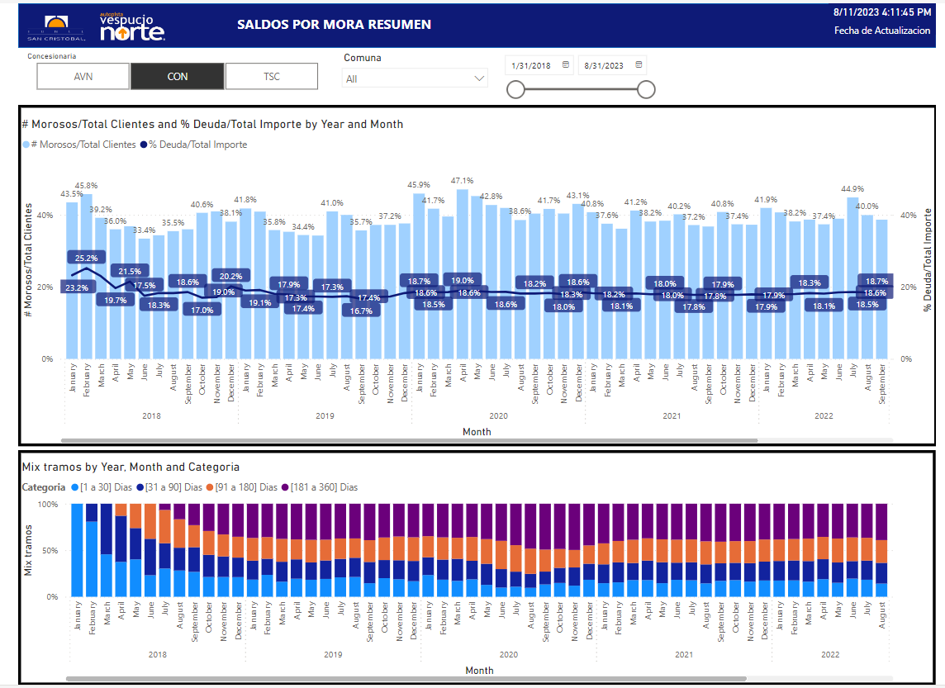
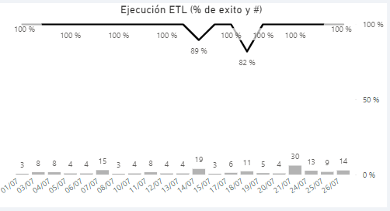
VESPUCIO DATA PROJECT
PART 2 – GENERAL OVERVIEW
UNLOCKING EFFICIENCY GAINS BY TRANSITIONING TO A CLOUD DATA PLATFORM
Vespucio has launched the implementation of a cloud data warehouse leveraging the snowflake Data Cloud. Snowflake’s scalability and cloud-based tools allow management to leverage previously isolated data silos
470 M
transactions onboarded
Improve visibility on toll collection operations
Generalize automation of repetitive tasks
✓
Close monitoring of toll collections by combining tolling and payments data
✓
Automated data processing used to involve several employees from various teams, now monitored through one central dashboard
✓
Build a holistic view of collections across roads, customer types and time periods thanks to increased scalability
✓
Automated updates bringing update frequency from 1 month to 4 hours
Break down data silos to unlock new use cases
Backed up by robust data governance tools.
Develop modern business intelligence skills in-house.
Ardian’s IT and Data science team played a key role advising Vespucio’s management team during the RFP process
Vespucio’s finance team is actively contributing to the development of new reports. Developing the necessary skills to ensure a smooth transition after the implementation phase.
Large volume of data used to make cross-dataset computation difficult to handle on-premise. Promising use cases are emerging on forecasting and customer analysis.
New data platform is streamlining access to data and putting it directly in the hands of end-users. Turning the significant data generation potential of Vespucio’s free-flow, electronic toll gantries into operational efficiencies.

Slide 11

APPENDIX

